Slide 1
Indiana University Bloomington
Data mining research Presentation
MOVIE SALES DATA ANALYSIS AND REVENUE PREDICTION
Presented by :
1. Kaushik Shridhar
2. Pratik Gholap.
3. Ruturaj Marathe.

Slide 2

Contents
Problem Definition
Solution
Data Scraping
Data cleaning and preprocessing
Data visualization
Data modeling

Slide 3
Problem Definition
Predicting the box office revenue of movies before their release is a crucial challenge for film industry. Leveraging comprehensive datasets encompassing various movie attributes such as director, cast, actors and genre, this project aims to find relations between features and develop a predictive model. The model will estimate the gross revenue a movie is likely to generate upon its release, aiding studios, investors, and distributors in optimizing marketing strategies and resource allocation.

Slide 4
Solution
Scrapped the data from IMDB, OMDB, Box Mojo.
Performed data cleaning and preprocessing for 2 datasets.
Built a revenue prediction model with accuracy nearing to 70% for a dataset provided by Professor.
Modeled 5 to 7 relations between attributes of movie dataset.
Identified potential relations between the attributes by applying data visualizations on scraped data.

Slide 5
Data Scraping
1. IMDB:
The dataset includes attributes such as title, caption, aggregate_rating, vote_count, released_quarter, certificate, genre, directors, actors, and plot, along with the metascore.
Data was gathered for the period from 2015 to 2022
.

Slide 6
Data Scraping
2. Box Mojo & OMDB:
Data was gathered for the period from 2004 to 2022, including attributes such as movie_id, movie_title, and gross_revenue. Box Mojo's public dataset contains records for 200 movies per year.
Additional movie attributes were sourced from OMDB, including caption, aggregate_rating, released_quarter, certificate, genre, directors, actors, plot, metascore, Rotten Tomatoes rating, Metacritic rating, IMDb rating, IMDb votes, writer, and release date.
.

Slide 7
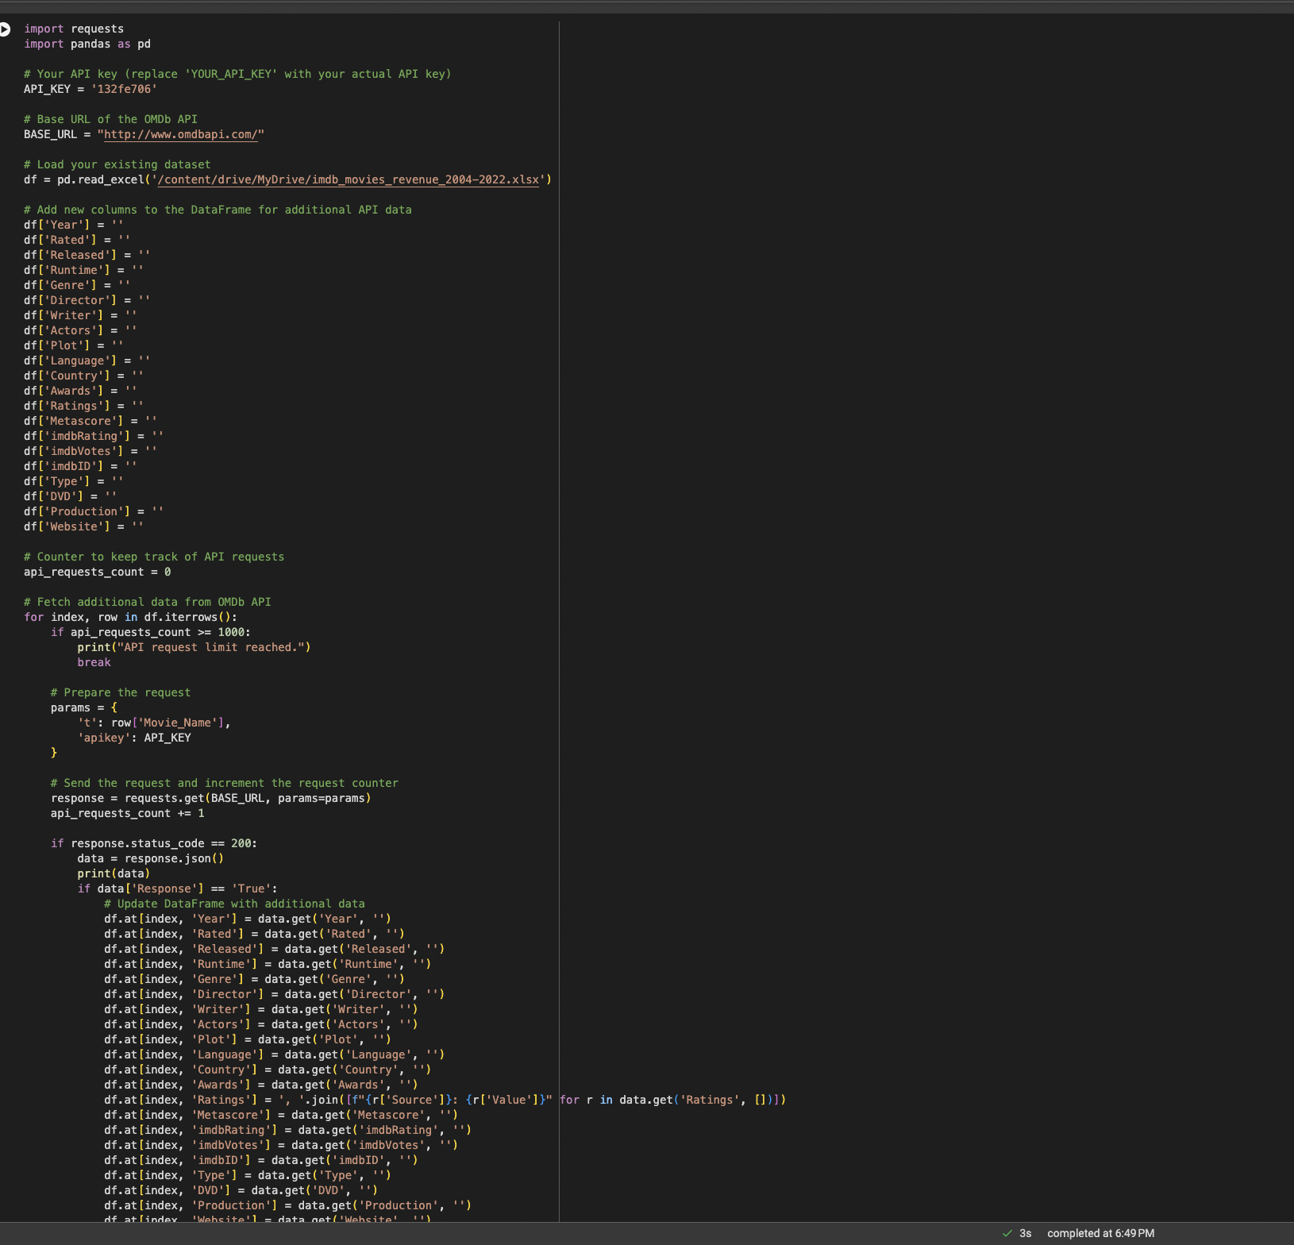
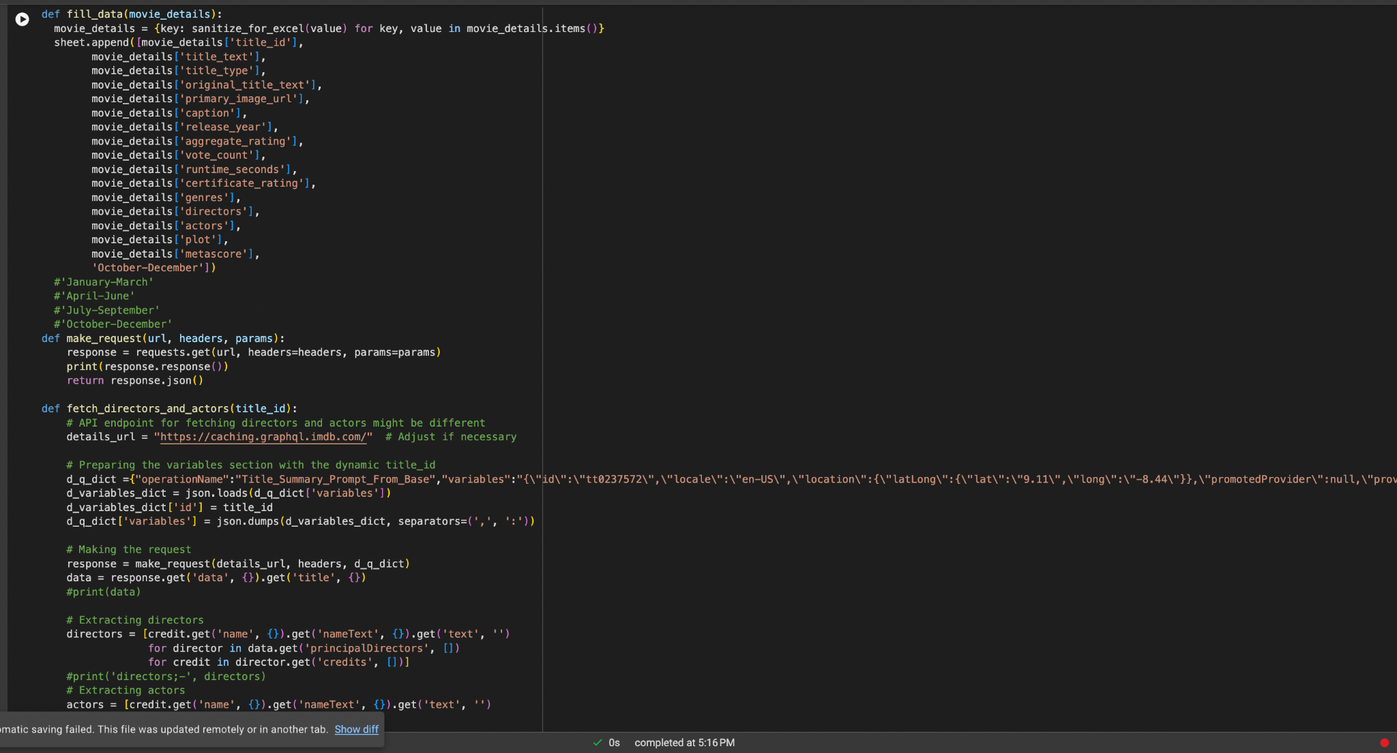
Data Scraping
.

Slide 8
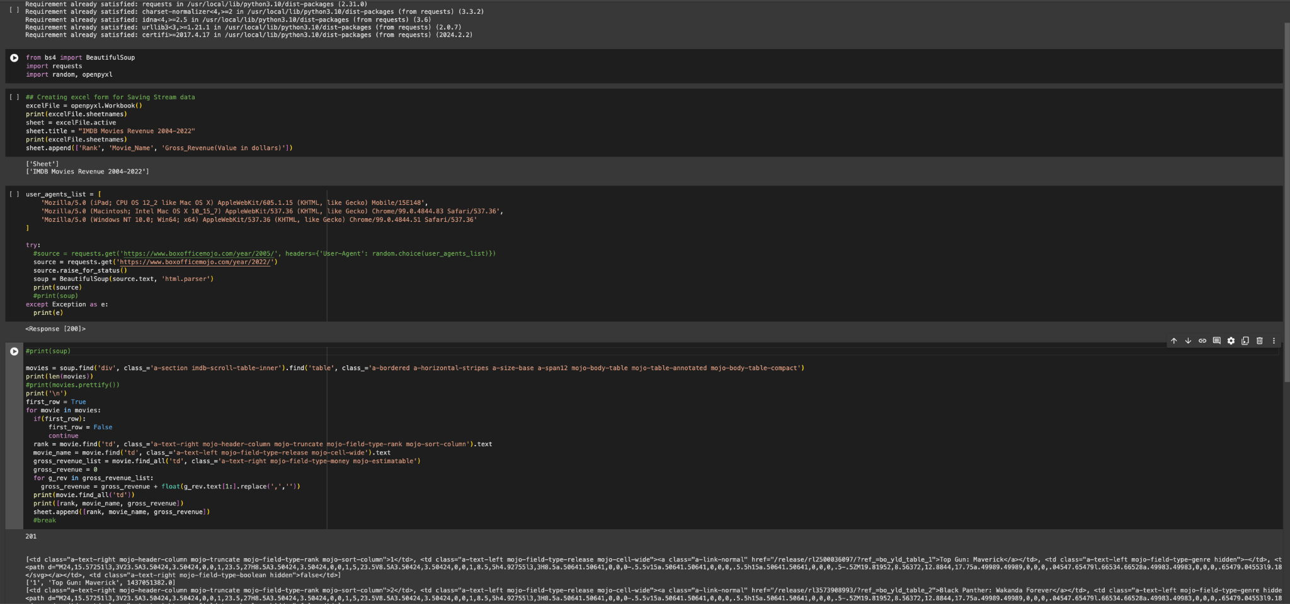
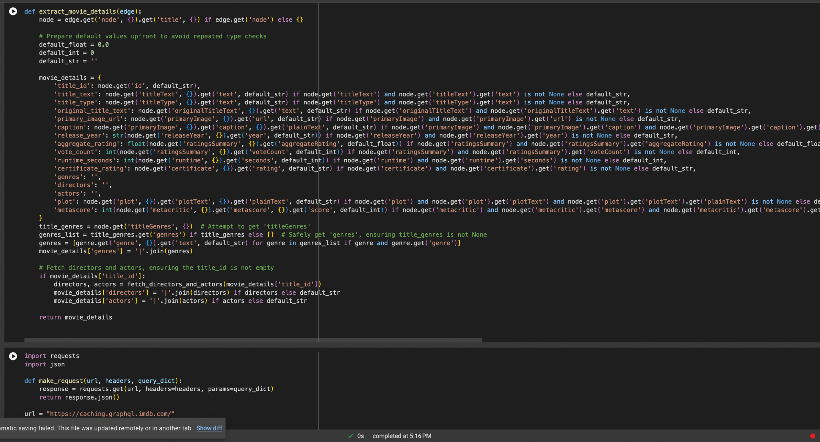
Data Scraping
.

Slide 9
Data cleaning and Preprocessing
Null values - mean, median imputation, dropping of some null values.
Textual Data -
Vectorization - 1. TF-ID importance of a word in a document relative to a collection of documents. 2. Word2vec - word embedding technique used to represent words in a continuous vector space
Lemmatization - word's meaning and context is used to produce the base word
Stemming - reducing words to their root or base form.(eg: running : run)
Numeric data
Performed Min-Max scaling wherever necessary
Create new features by combining or transforming existing ones to improve model performance.
.

Slide 10
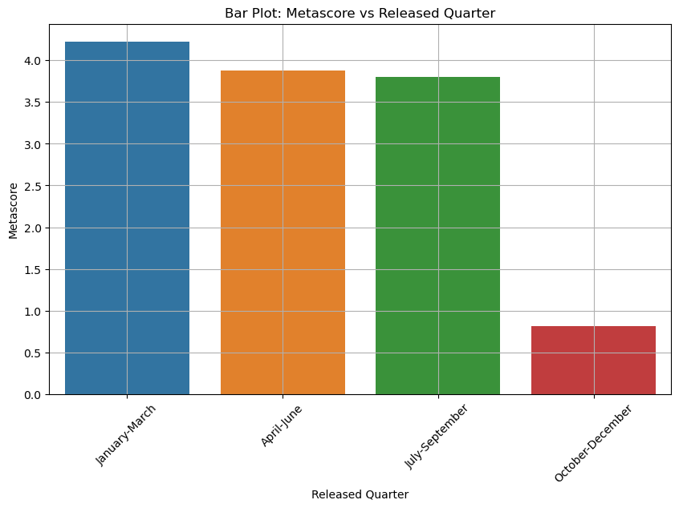
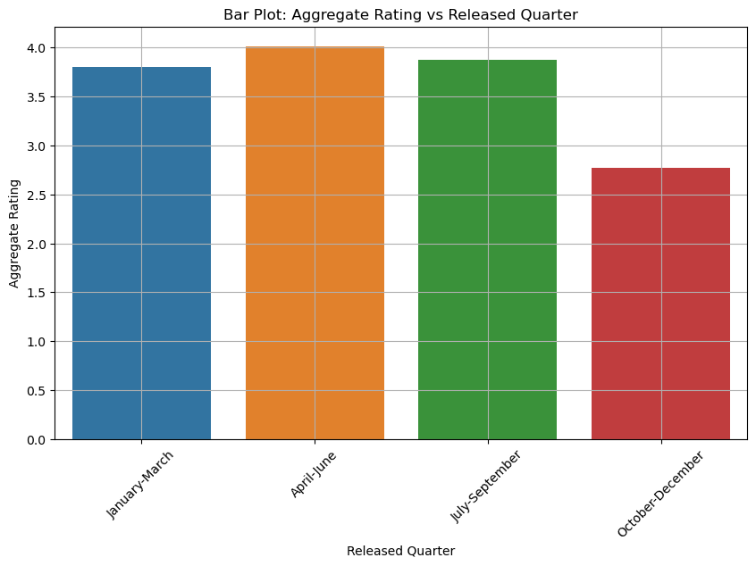
Data Visualizations

Slide 11
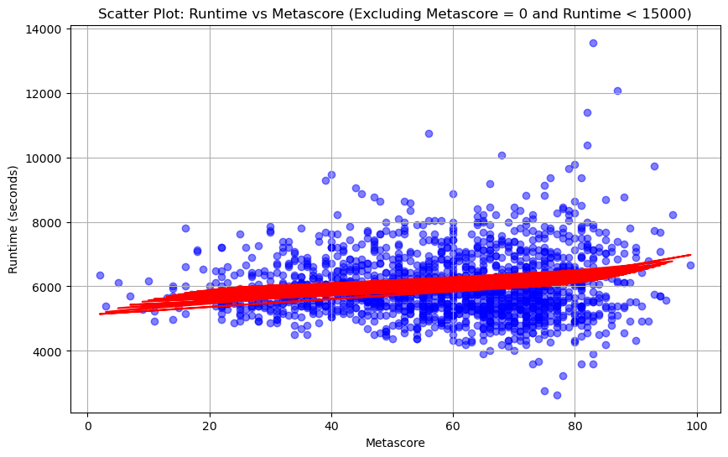
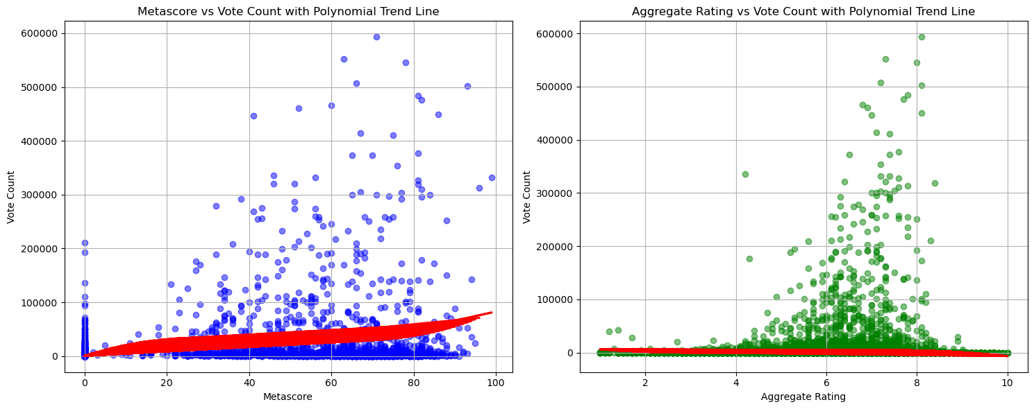
Vote_counts and runtime of the movie are slightly correlated to each other.

Slide 12
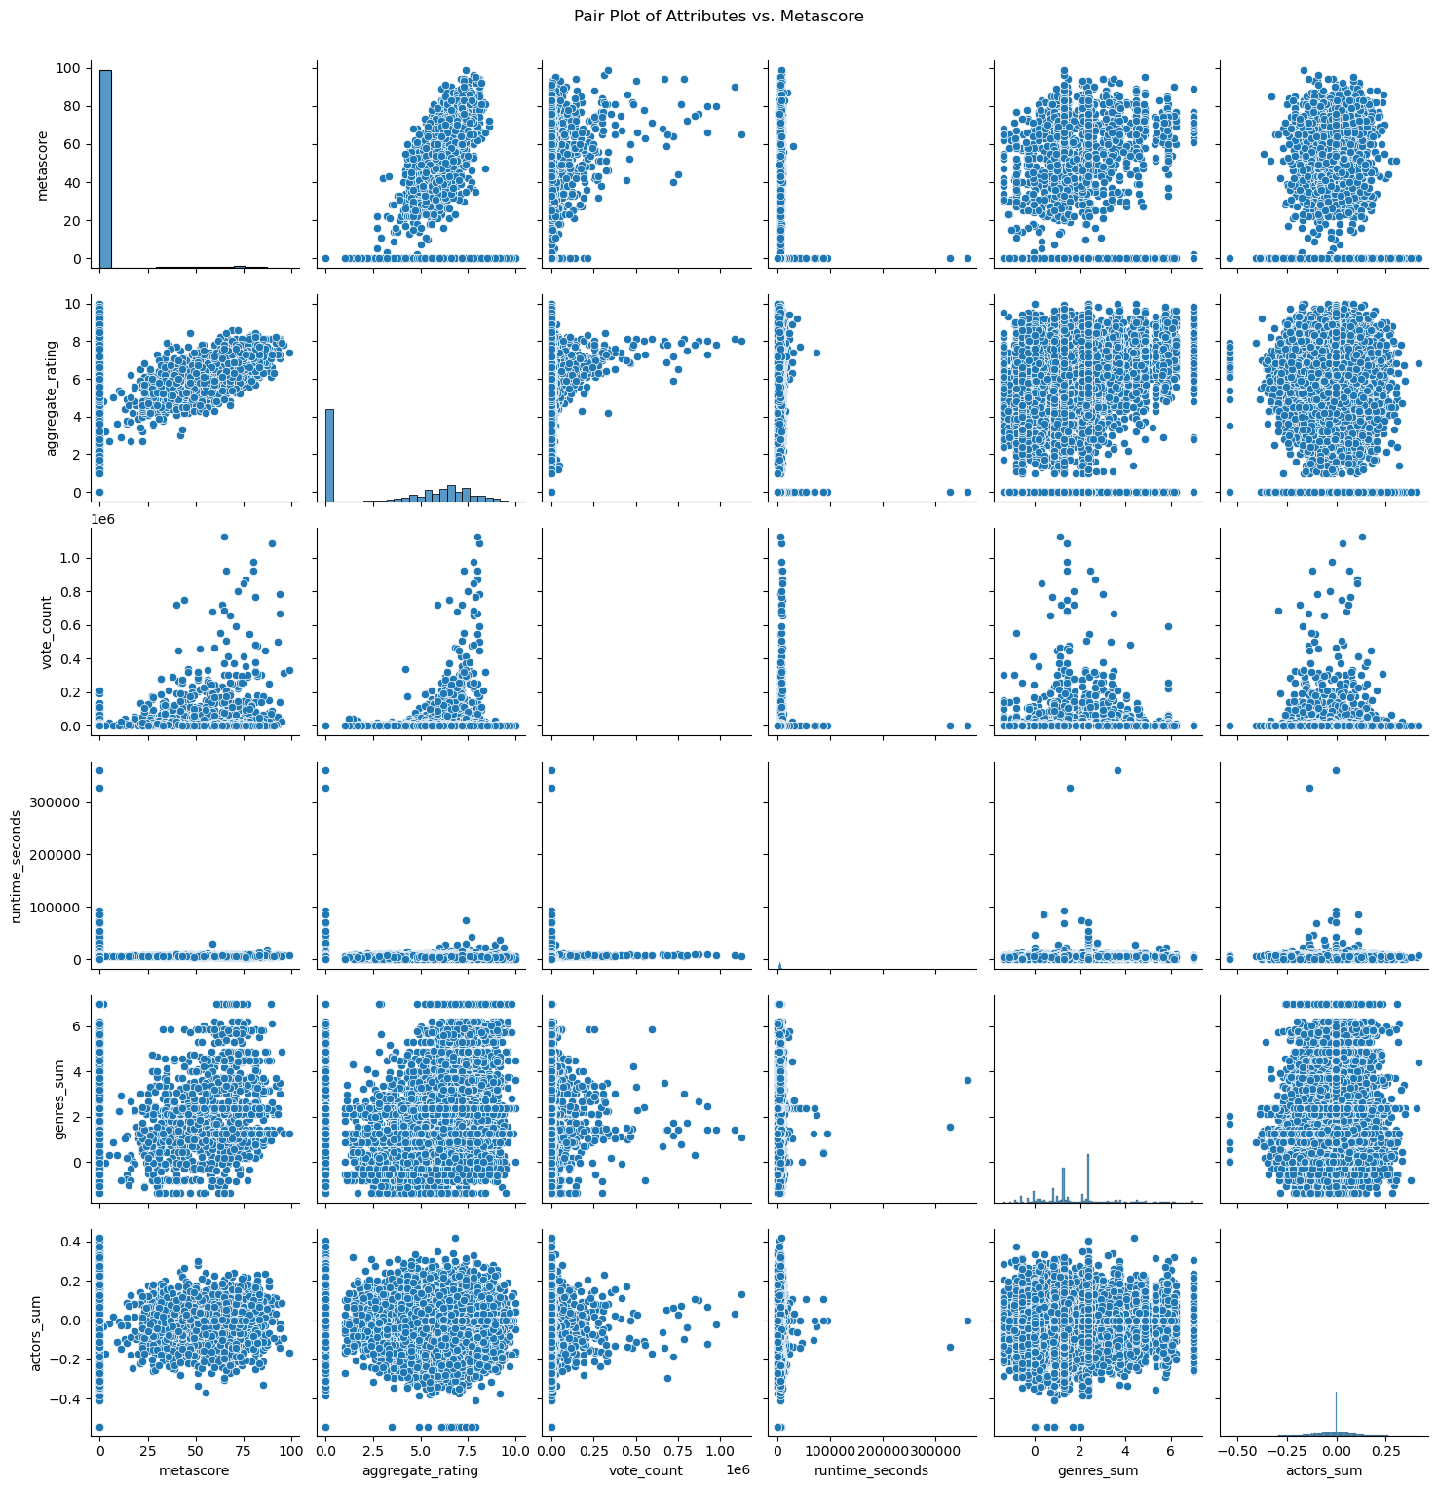
Strong correlations:
Aggregate_rating and metascore
Moderate correlations:
Vote_counts and metascore,aggregate_rating.
Weak correlation:
Metascore and genre.
Thus we can say that genre, metascore,vote_counts,aggregate rating affect the rating of the movie.
Good rating = good revenue

Slide 13
Data modeling
Main focus on 2 models:
Regression Model for predicting revenue
Deep learning
Random forest
Classification Model for assigning a class based revenue such as low, high, etc.
Random forest
Decision tree
Modelled relations:
Actor-Actor relations
Actor-Movie relations
Movie-Movie relations
Director-Movie relations
Other relations:
Genre - ratings
Quarters - ratings
.

Slide 14
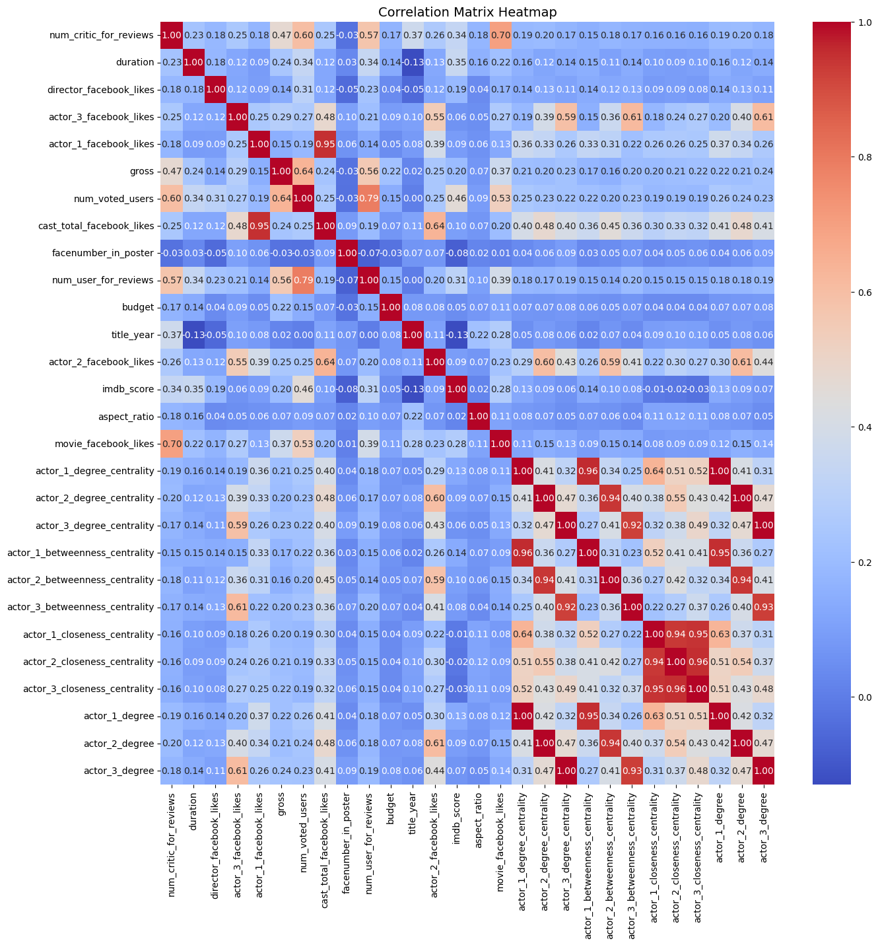

Slide 15
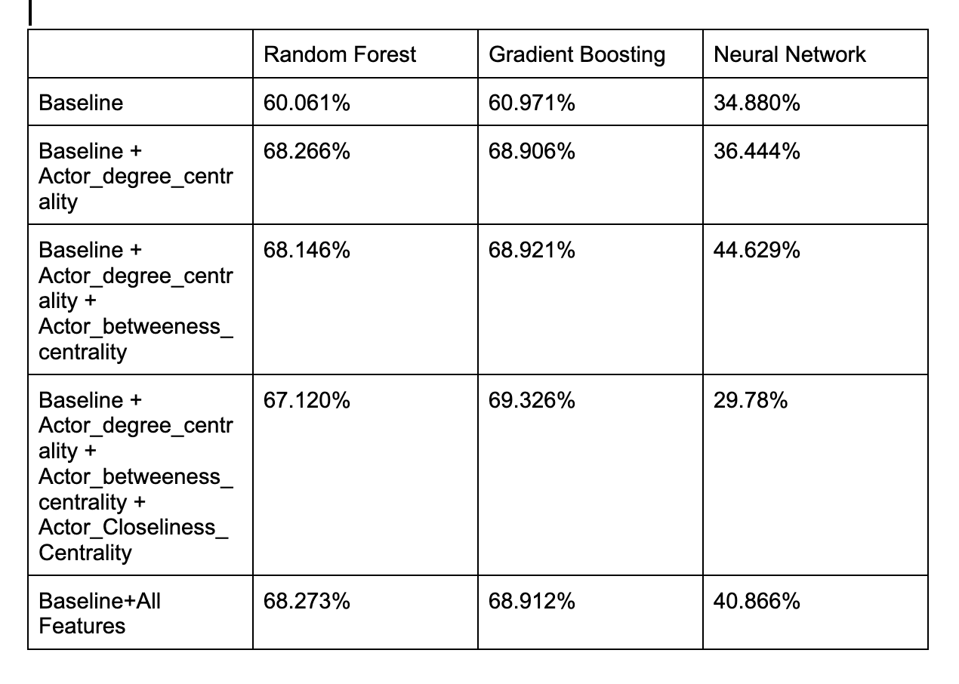

Slide 16
Thank you
Professor - for providing the dataset and quarter based analysis suggestion.
https://snap.stanford.edu/class/cs224w-2015/projects_2015/Predicting_Box_Office_Revenue_for_Movies.pdf [Matt Vitelli]
Omdb - for providing 1000 API requests per day for free.
https://scholar.harvard.edu/tlan/box-office-prediction
https://arxiv.org/ftp/arxiv/papers/1804/1804.03565.pdf

